Slide 1



PARULINSTITUTEOF ENGINEERING &TECHNOLOGY
FACULTY OF ENGINEERING & TECHNOLOGY
PARULUNIVERSITY
Database Management System
Relational Database Design
Computer Science & Engineering

Slide 2



Outline
Functional Dependency (FD) and its Types
Armstrong's axioms OR Inference rules
Closure of a set of FDs
Closure of attribute sets
Decomposition
Anomaly and its types
Normalization and normal forms

Slide 3
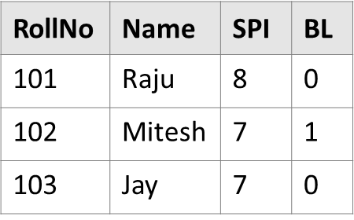
What is Functional Dependency(FD)
Let R be a relation schema having n attributes A1, A2, A3,…, An.
Let attributes X and Y are two subsets of attributes of relation R.
If the values of the X component of a tuple uniquely (or functionally) determine the values of the Y component, then there is a functional dependency from X to Y.
This is denoted by X → Y (i.e RollNo → Name, SPI, BL).
It is referred as: Y is functionally dependent on the X or X functionally determines Y.
Student

Slide 4
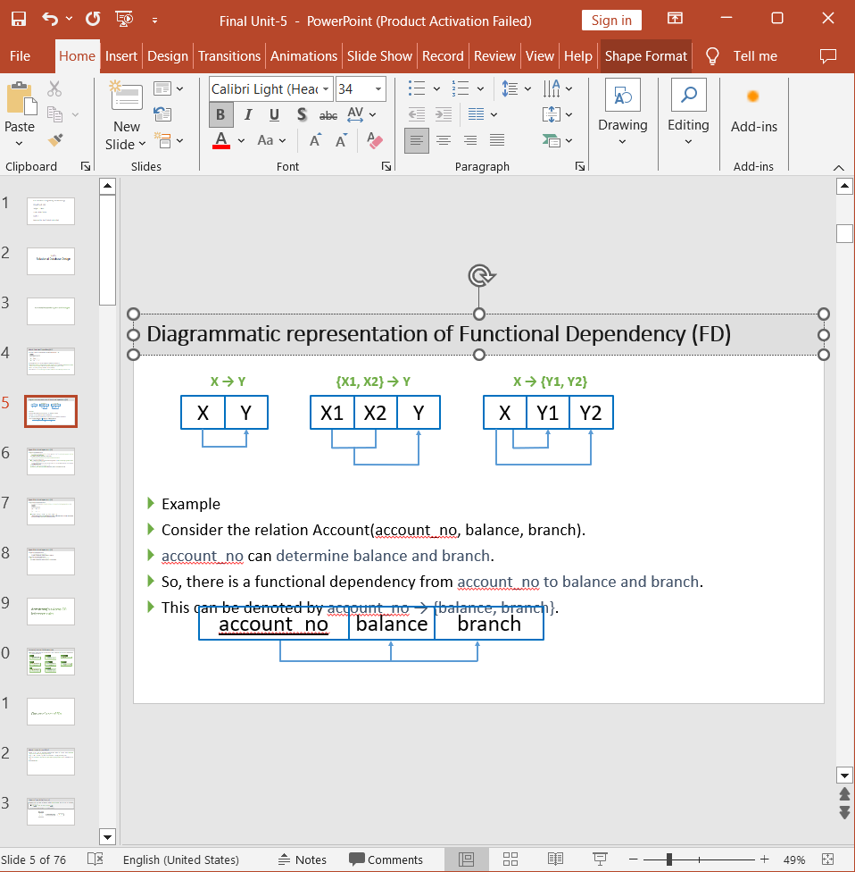
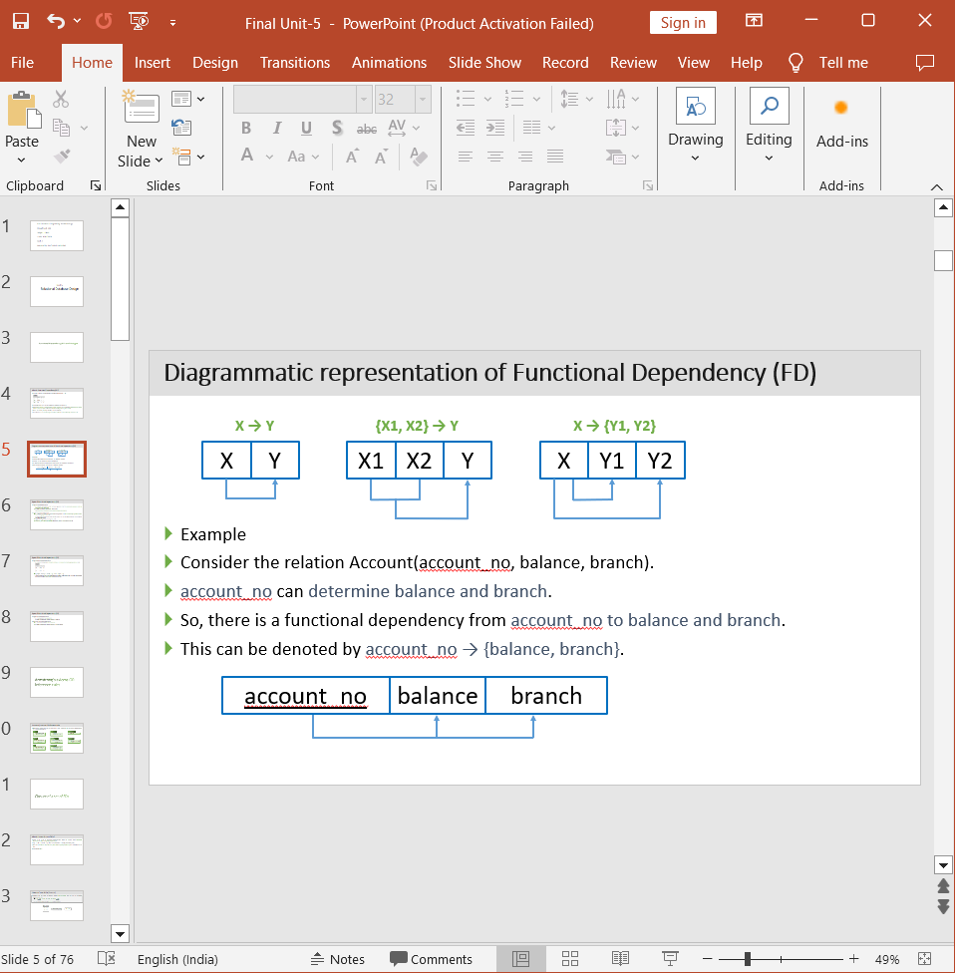
Example
Consider the relation Account(account_no, balance, branch).
account_no can determine balance and branch.
So, there is a functional dependency from account_no to balance and branch.
This can be denoted by account_no → {balance, branch}.
Diagrammatic representation of Functional Dependency (FD)

Slide 5
Types of Functional Dependency (FD)
Full Functional Dependency
In a relation, the attribute B is fully functional dependent on A if B is functionally dependent on A, but not on any proper subset of A.
Eg. {Roll_No, Semester, Department_Name} → SPI
We need all three {Roll_No, Semester, Department_Name} to find SPI.
Partial Functional Dependency
In a relation, the attribute B is partial functional dependent on A if B is functionally dependent on A as well as on any proper subset of A.
If there is some attribute that can be removed from A and the still dependency holds then it is partial functional dependancy.
Eg. {Enrollment_No, Department_Name} → SPI
Enrollment_No is sufficient to find SPI, Department_Name is not required to find SPI.

Slide 6

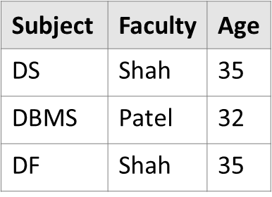
Types of Functional Dependency (FD)
Transitive Functional Dependency
In a relation, if attribute(s) A → B and B → C, then A → C (means C is transitively depends on A via B).
Eg. Subject → Faculty & Faculty → Age then Subject → Age
Therefore as per the rule of transitive dependency: Subject → Age should hold, that makes sense because if we know the subject name we can know the faculty’s age.

Slide 7
Types of Functional Dependency (FD)
Trivial Functional Dependency
X → Y is trivial FD if Y is a subset of X
Eg. {Roll_No, Department_Name, Semester} → Roll_No
Nontrivial Functional Dependency
X → Y is nontrivial FD if Y is not a subset of X
Eg. {Roll_No, Department_Name, Semester} → Student_Name

Slide 8
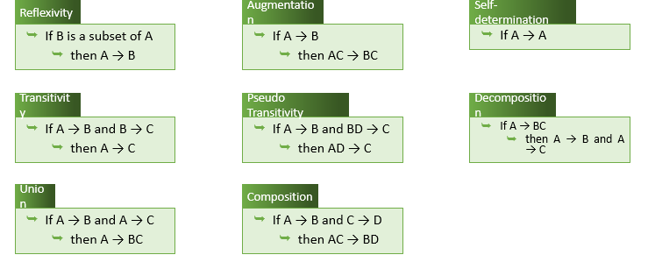
Armstrong's axioms OR Inference rules
Armstrong's axioms are a set of rules used to infer (derive) all the functional dependencies on a relational database.

Slide 9
What is closure of a set of FDs?
Given a set F set of functional dependencies, there are certain other functional dependencies that are logically implied by F.
E.g.: F = {A → B and B → C}, then we can infer that A → C (by transitivity rule)
The set of functional dependencies (FDs) that is logically implied by F is called the closure of F.
It is denoted by F⁺.

Slide 10
Closure of a set of FDs [Example]
Suppose we are given a relation schema R(A,B,C,G,H,I) and the set of functional dependencies are:
F = (A → B, A → C, CG → H, CG → I, B → H)
The functional dependency A → H is logical implied.
We have
A → B
B → H
Transitivity rule
A → H

Slide 11
Closure of a set of FDs [Example]
Suppose we are given a relation schema R(A,B,C,G,H,I) and the set of functional dependencies are:
F = (A → B, A → C, CG → H, CG → I, B → H)
The functional dependency CG → HI is logical implied.
We have
CG → H
CG → I
Union rule
CG → HI

Slide 12
Closure of a set of FDs [Example]
Suppose we are given a relation schema R(A,B,C,G,H,I) and the set of functional dependencies are:
F = (A → B, A → C, CG → H, CG → I, B → H)
The functional dependency AG → I is logical implied.
We have
A → C
CG → I
Pseudo-transitivity rule
AG → I

Slide 13
Closure of a set of FDs [Example]
Suppose we are given a relation schema R(A,B,C,G,H,I) and the set of functional dependencies are:
F = (A → B, A → C, CG → H, CG → I, B → H)
The functional dependency AG → I is logical implied.
We have
A → C
Augmentation rule
AG → CG
AG → CG
CG → I
Transitivity rule
AG → I

Slide 14
Closure of a set of FDs [Example]
Suppose we are given a relation schema R(A,B,C,G,H,I) and the set of functional dependencies are:
F = (A → B, A → C, CG → H, CG → I, B → H)
Find out the closure of F.
F⁺ = (A → H, CG → HI, AG → I)

Slide 15
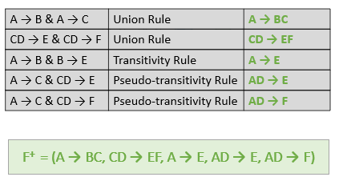
Closure of a set of FDs [Example]
Compute the closure of the following set F of functional dependencies FDs for relational schema R = (A,B,C,D,E,F):
F = (A → B, A → C, CD → E, CD → F, B → E)
Find out the closure of F.

Slide 16
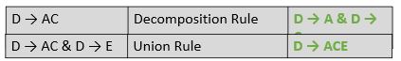
Closure of a set of FDs [Example]
Compute the closure of the following set F of functional dependencies FDs for relational schema R = (A,B,C,D,E):
F = (AB → C, D → AC, D → E )
Find out the closure of F.
F⁺ = (D → A, D → C, D → ACE)

Slide 17
What is a closure of attribute sets?
Given a set of attributes α, the closure of α under F is the set of attributes that are functionally determined by α under F.
It is denoted by α⁺.
Algorithm
Algorithm to compute α⁺, the closure of α under F
Steps
result = α
while (changes to result) do
for each β → γ in F do
begin
if β ⊆ result then result = result U γ
else result = result
end

Slide 18

Closure of attribute sets [Example]
Consider the relation schema R = (A, B, C, G, H, I).
For this relation, a set of functional dependencies F can be given as
F = {A → B, A → C, CG → H, CG → I, B → H}
Find out the closure of (AG)⁺.
Step 1.
result = α => result = AG
Algorithm
Algorithm to compute α⁺, the closure of α under F
Steps
result = α
while (changes to result) do
for each β → γ in F do
begin
if β ⊆ result then result = result U γ
else result = result
end
AG⁺ = ABCGHI

Slide 19
Closure of attribute sets [Exercise]
Given functional dependencies (FDs) for relational schema
R = (A,B,C,D,E):
F = {A → BC, CD → E, B → D, E → A}
Find Closure for A
Find Closure for CD
Find Closure for B
Find Closure for BC
Find Closure for E
Answer
A⁺ = ABCDE
CD⁺ = ABCDE
B⁺ = BD
BC⁺ = ABCDE
E⁺ = ABCDE

Slide 20
What is decomposition?
Decomposition is the process of breaking down given relation into two or more relations.
Relation R is replaced by two or more relations in such a way that:
Each new relation contains a subset of the attributes of R
Together, they all include all tuples and attributes of R
Types of decomposition
Lossy decomposition
Lossless decomposition (non-loss decomposition)

Slide 21
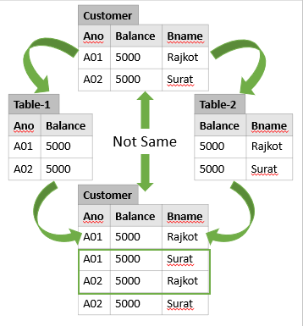
Lossy decomposition
The decomposition of relation R into R1 and R2 is lossy when the join of R1 and R2 does not yield the same relation as in R.
This is also referred as lossy-join decomposition.
The disadvantage of such kind of decomposition is that some information is lost during retrieval of original relation.
From practical point of view, decomposition should not be lossy decomposition.

Slide 22
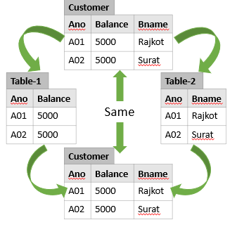
Lossless decomposition
The decomposition of relation R into R1 and R2 is lossless when the join of R1 and R2 produces the same relation as in R.
This is also referred as a non-additive (non-loss) decomposition.
All decompositions must be lossless.

Slide 23
What is an anomaly in database design?
Anomalies are problems that can occur in poorly planned, un-normalized database where all the data are stored in one table.
There are three types of anomalies that can arise in the database because of redundancy are
Insert anomaly
Delete anomaly
Update / Modification anomaly

Slide 24
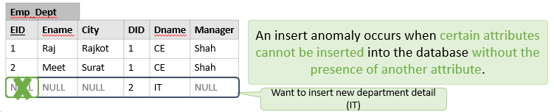
Insert anomaly
Consider a relation Emp_Dept(EID, Ename, City, DID, Dname, Manager) EID as a primary key
Suppose a new department (IT) has been started by the organization but initially there is no employee appointed for that department.
We want to insert that department detail in Emp_Dept table.
But the tuple for this department cannot be inserted into this table as the EID will have NULL value, which is not allowed because EID is primary key.
This kind of problem in the relation where some tuple cannot be inserted is known as insert anomaly.

Slide 25
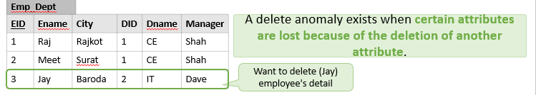
Delete anomaly
Consider a relation Emp_Dept(EID, Ename, City, DID, Dname, Manager) EID as a primary key
Now consider there is only one employee in some department (IT) and that employee leaves the organization.
So we need to delete tuple of that employee (Jay).
But in addition to that information about the department also deleted.
This kind of problem in the relation where deletion of some tuples can lead to loss of some other data not intended to be removed is known as delete anomaly.

Slide 26

Update anomaly
Consider a relation Emp_Dept(EID, Ename, City, Dname, Manager) EID as a primary key
Suppose the manager of a (CE) department has changed, this requires that the Manager in all the tuples corresponding to that department must be changed to reflect the new status.
If we fail to update all the tuples of given department, then two different records of employee working in the same department might show different Manager lead to inconsistency in the database.

Slide 27
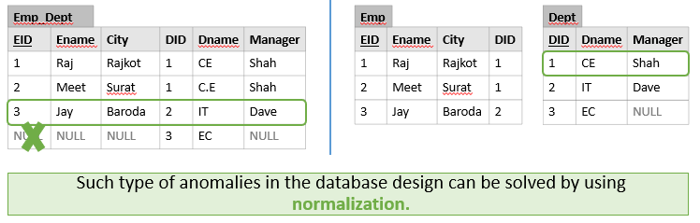
How to deal with insert, delete and update anomaly

Slide 28
What is normalization?
Normalization is the process of removing redundant data from tables to improve data integrity, scalability and storage efficiency.
data integrity (completeness, accuracy and consistency of data)
scalability (ability of a system to continue to function well in a growing amount of work)
storage efficiency (ability to store and manage data that consumes the least amount of space)
What we do in normalization?
Normalization generally involves splitting an existing table into multiple (more than one) tables, which can be re-joined or linked each time a query is issued (executed).

Slide 29
How many normal forms are there?
Normal forms:
1NF (First normal form)
2NF (Second normal form)
3NF (Third normal form)
BCNF (Boyce–Codd normal form)
4NF (Forth normal form)
5NF (Fifth normal form)
As we move from 1NF to 5NF number of tables and complexity increases but redundancy decreases.

Slide 30
1NF (First Normal Form)
Conditions for 1NF
A relation R is in first normal form (1NF) if and only if it does not contain any composite attribute or multi-valued attributes or their combinations.
OR
A relation R is in first normal form (1NF) if and only if all underlying domains contain atomic values only.
Each cells of a table should contain a single value.

Slide 31
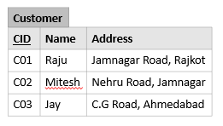
1NF (First Normal Form) [Example - Composite attribute]
Problem: It is difficult to retrieve the list of customers living in ’Jamnagar’ city from customer table.
The reason is that address attribute is composite attribute which contains road name as well as city name in single cell.
It is possible that city name word is also there in road name.
In our example, ’Jamnagar’ word occurs in both records, in first record it is a part of road name and in second one it is the name of city.
In customer relation address is composite attribute which is further divided into sub-attributes as “Road” and “City”.
So customer relation is not in 1NF.

Slide 32
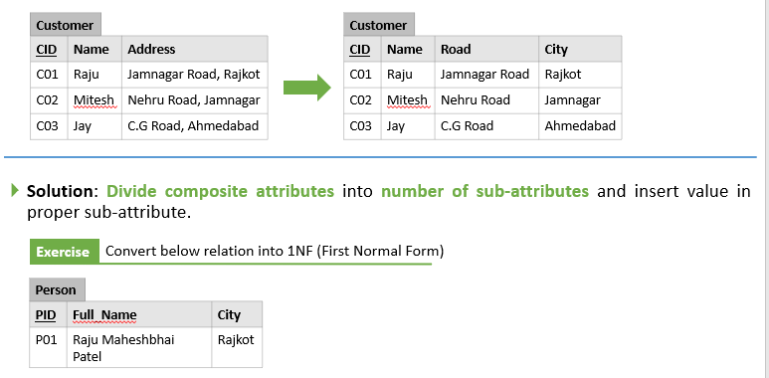
1NF (First Normal Form) [Example - Composite attribute]

Slide 33
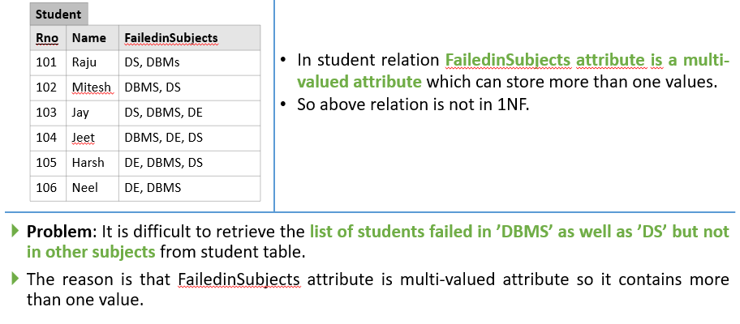
1NF (First Normal Form) [Example - Multivalued attribute]

Slide 34
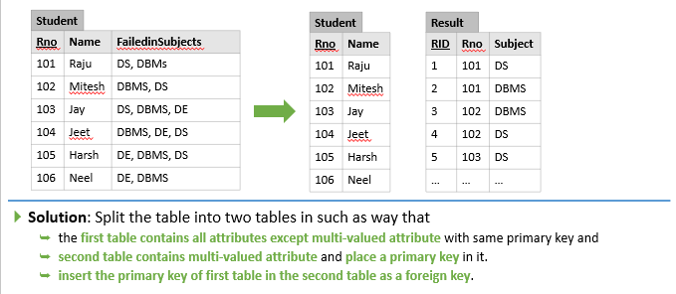
1NF (First Normal Form) [Example - Multivalued attribute]

Slide 35
2NF (Second Normal Form)
Conditions for 2NF
A relation R is in second normal form (2NF)
if and only if it is in 1NF and
every non-primary key attribute is fully dependent on the primary key
OR
A relation R is in second normal form (2NF)
if and only if it is in 1NF and
no any non-primary key attribute is partially dependent on the primary key
It is in 1NF and each table should contain a single primary key.

Slide 36
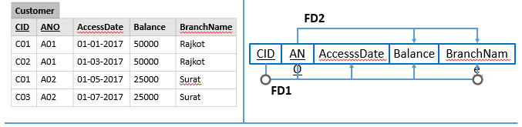
2NF (Second Normal Form) [Example]
FD1: {CID, ANO} → {AccesssDate, Balance, BranchName}
FD2: ANO → {Balance, BranchName}
Balance and BranchName are partial dependent on primary key (CID + ANO). So customer relation is not in 2NF.

Slide 37
2NF (Second Normal Form) [Example]
Problem: For example, in case of a joint account multiple (more than one) customers have common (one) accounts.
If an account ’A01’ is operated jointly by two customers says ’C01’ and ’C02’ then data values for attributes Balance and BranchName will be duplicated in two different tuples of customers ’C01’ and ’C02’.

Slide 38
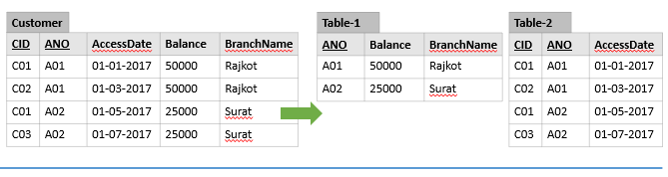
Solution: Decompose relation in such a way that resultant relations do not have any partial FD.
Remove partial dependent attributes from the relation that violets 2NF.
Place them in separate relation along with the prime attribute on which they are fully dependent.
The primary key of new relation will be the attribute on which it is fully dependent.
Keep other attributes same as in that table with the same primary key.
2NF (Second Normal Form) [Example]

Slide 39
3NF (Third Normal Form)
Conditions for 3NF
A relation R is in third normal form (3NF)
if and only if it is in 2NF and
every non-key attribute is non-transitively dependent on the primary key
OR
A relation R is in third normal form (3NF)
if and only if it is in 2NF and
no any non-key attribute is transitively dependent on the primary key
It is in 2NF and there is no transitive dependency.
(Transitive dependency???) A → B & B → C then A → C

Slide 40
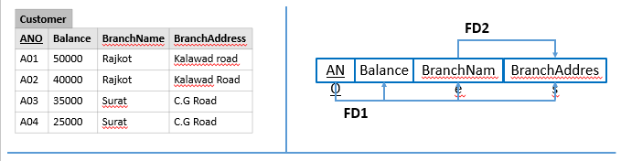
3NF (Third Normal Form) [Example]
FD1: ANO → {Balance, BranchName, BranchAddress}
FD2: BranchName → BranchAddress
So AccountNO → BranchAddress (Using Transitivity rule)
BranchAddress is transitive depend on primary key (ANO). So customer relation is not in 3NF.

Slide 41
3NF (Third Normal Form) [Example]
Problem: In this relation, branch address will be stored repeatedly for each account of the same branch which occupies more space.

Slide 42
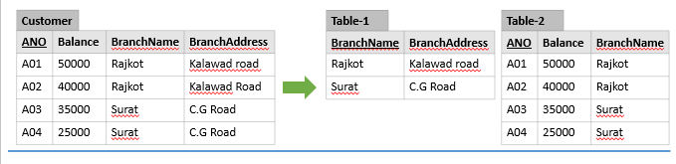
3NF (Third Normal Form) [Example]
Solution: Decompose relation in such a way that resultant relations do not have any transitive FD.
Remove transitive dependent attributes from the relation that violets 3NF.
Place them in a new relation along with the non-prime attributes due to which transitive dependency occurred.
The primary key of the new relation will be non-prime attributes due to which transitive dependency occurred.
Keep other attributes same as in the table with same primary key and add prime attributes of other relation into it as a foreign key.

Slide 43

BCNF (Boyce-Codd Normal Form)
A relation R is in Boyce-Codd normal form (BCNF)
if and only if it is in 3NF and
for every functional dependency X → Y, X should be the primary key of the table. OR
A relation R is in Boyce-Codd normal form (BCNF)
if and only if it is in 3NF and
every prime key attribute is non-transitively dependent on the primary key OR
A relation R is in Boyce-Codd normal form (BCNF)
if and only if it is in 3NF and
no any prime key attribute is transitively dependent on the primary key

Slide 44
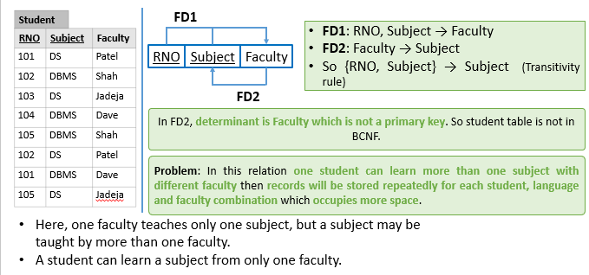
BCNF (Boyce-Codd Normal Form) [Example]

Slide 45
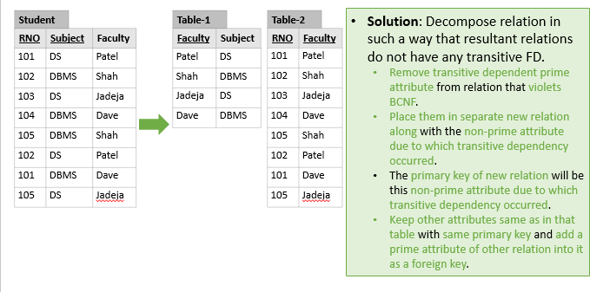
BCNF (Boyce-Codd Normal Form) [Example]

Slide 46
Multivalued dependency (MVD)
For a dependency X → Y, if for a single value of X, multiple values of Y exists, then the table may have multi-valued dependency.
Multivalued dependency (MVD) is denoted by →→
Multivalued dependency (MVD) is represented as X →→ Y
Student
RNO | Subject | Faculty
101 | DS | Patel
101 | DBMS | Patel
101 | DS | Shah
101 | DBMS | Shah

Slide 47
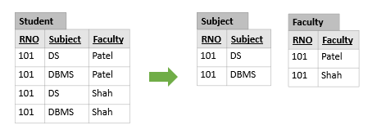
4NF (Forth Normal Form)
Conditions for 4NF
A relation R is in fourth normal form (4NF)
if and only if it is in BCNF and
has no multivalued dependencies
Above student table has multivalued dependency. So student table is not in 4NF.

Slide 48
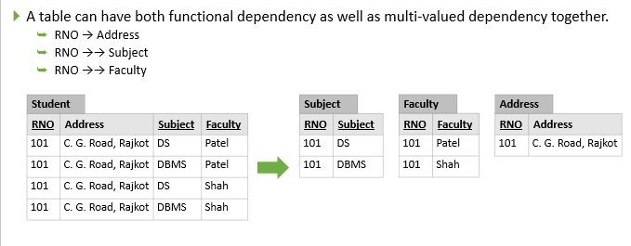
Functional dependency & Multivalued dependency

Slide 49

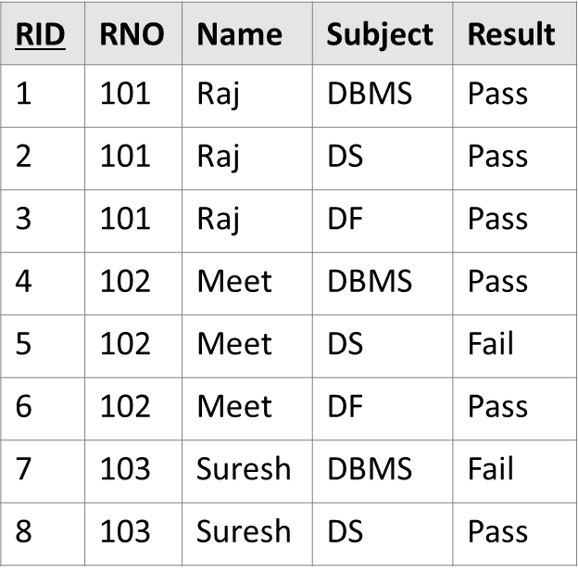
5NF (Fifth Normal Form)
Conditions for 5NF
A relation R is in fifth normal form (5NF)
if and only if it is in 4NF and
it cannot have a lossless decomposition in to any number of smaller tables (relations).
Student_Result relation is further decomposed into sub-relations. So the above relation is not in 5NF.

Slide 50
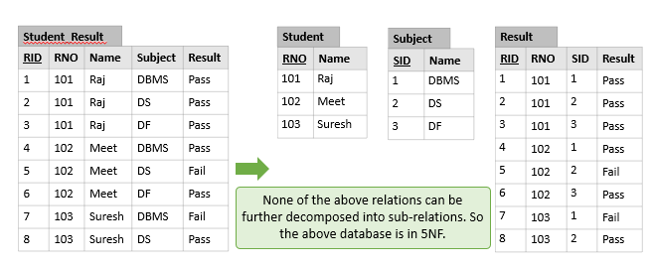
5NF (Fifth Normal Form)

Slide 51
How to find key?
Conditions to find key
The attribute is a part of key, if it does not occur on any side of FD
The attribute is a part of key, if it occurs on the left-hand side of an FD, but never occurs on the right-hand side
The attribute is not a part of key, if it occurs on the right-hand side of an FD, but never occurs on the left-hand side
The attribute may be a part of key or not, if it occurs on the both side of an FD

Slide 52
How to find key? [Example]
Let a relation R with attributes ABCD with FDs C → A, B → C. Find keys for relation R.
attribute not occur on any side of FDs (D) √
attribute occurs on only left-hand side of an FDs (B) √
attribute occurs on only right-hand side of an FDs (A) X
attribute occurs on both the sides of an FDs (C) ?
The core is BD.
B determines C and C determines A, So using transitivity rule B determines A also.
So BD is a key.

Slide 53
How to find key? [Exercise]
Let a relation R with attributes ABCD with FDs C → D, C → A and B → C. Find keys for relation R.
The core is B. B determines C which determines A and D, so B is a key. Therefore B is the key.
Let a relation R with attributes ABCD with FDs B → C, D → A. Find keys for relation R.
The core is BD. B determines C and D determines A, so BD is a key. Therefore BD is the key.
Let a relation R with attributes ABCD with FDs A → B, BC → D and A → C. Find keys for relation R.
The core is A. A determines B and C which determine D, so A is a key. Therefore A is the key.

Slide 54
Find (candidate) key & check for normal forms [Example]
Suppose you are given a relation R with four attributes ABCD. For each of the following sets of FDs, do the following: F = (B → C, D → A)
Identify the candidate key(s) for R.
Identify the best normal form that R satisfies (1NF, 2NF, 3NF or BCNF).
Candidate Key is BD
Relation R is in 1NF but not 2NF. In above FDs, there is a partial dependency
(As per FD B → C, C depends only on B but Key is BD so C is partial depends on key (BD))
(As per FD D → A, A depends only on D but Key is BD so A is partial depends on key (BD))

Slide 55
Find (candidate) key & check for normal forms [Example]
Suppose you are given a relation R with four attributes ABCD. For each of the following sets of FDs, do the following: F = (C → D, C → A, B → C)
Identify the candidate key(s) for R.
Identify the best normal form that R satisfies (1NF, 2NF, 3NF or BCNF).
Candidate Key is B
Relation R is in 2NF but not 3NF. In above FDs, there is a transitive dependency
(As per FDs B → C & C → D then B → D so D is transitive depends on key (B))
(As per FDs B → C & C → A then B → A so A is transitive depends on key (B))

Slide 56
Find (candidate) key & check for normal forms [Example]
Suppose you are given a relation R with four attributes ABCD. For each of the following sets of FDs, do the following: F = (ABC → D, D → A)
Identify the candidate key(s) for R.
Identify the best normal form that R satisfies (1NF, 2NF, 3NF or BCNF).
Candidate Key are ABC & BCD
Relation R is in 3NF but not BCNF.
In the above FDs, both FDs have prime attribute (D and A) in dependent (right) side.

Slide 57
How to normalize database?
A software contract and consultancy firm maintains details of all the various projects in which its employees are currently involved. These details comprise: Employee Number, Employee Name, Date of Birth, Department Code, Department Name, Project Code, Project Description, Project Supervisor.
Assume the following:
Each employee number is unique.
Each department has a single department code.
Each project has a single code and supervisor.
Each employee may work on one or more projects.
Employee names need not necessarily be unique.
Project Code, Project Description and Project Supervisor are repeating fields.
Normalize this data to Third Normal Form.

Slide 58

How to normalize database?
A software contract and consultancy firm maintains details of all the various projects in which its employees are currently involved. These details comprise: Employee Number, Employee Name, Date of Birth, Department Code, Department Name, Project Code, Project Description, Project Supervisor.
Employee Number | Employee Name | Date of Birth | Department Code | Department Name | Project Code | Project Description | Project Supervisor
1 | Raj | 1-1-85 | 1 | CE | 1 | IOT | Patel
2 | Meet | 4-4-86 | 2 | EC | 2 | PHP | Shah
3 | Suresh | 2-2-85 | 1 | CE | 1 | IOT | Patel
1 | Raj | 1-1-85 | 1 | CE | 2 | PHP | Shah

Slide 59

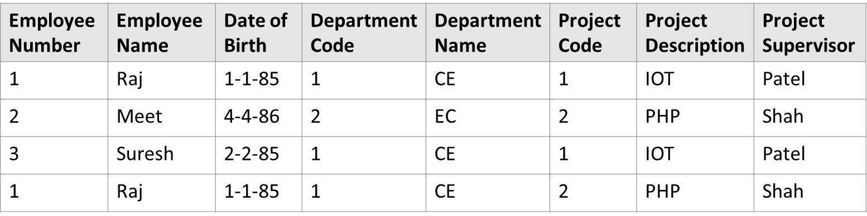
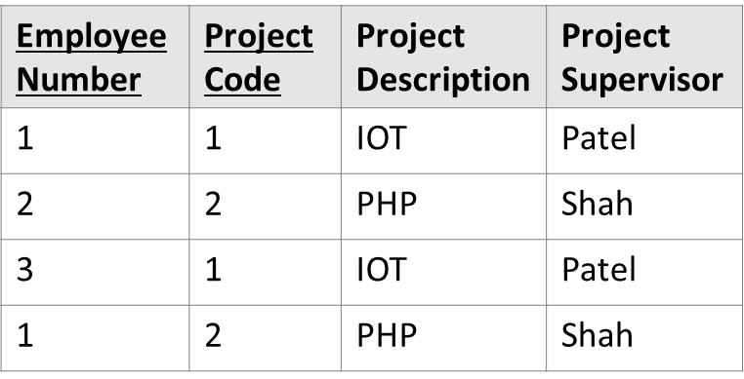
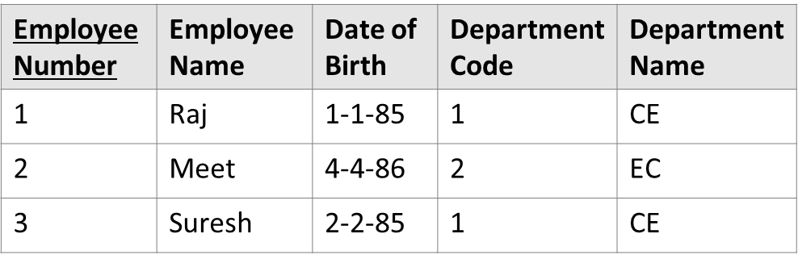
How to normalize database?
1NF

Slide 60
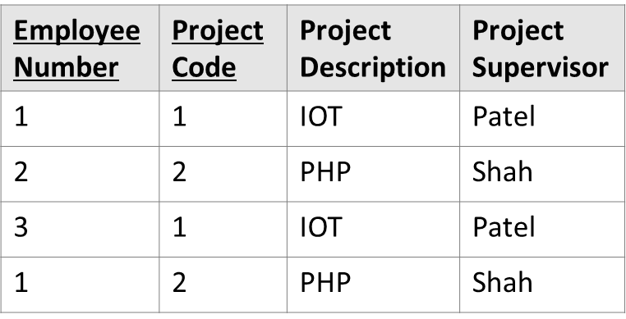
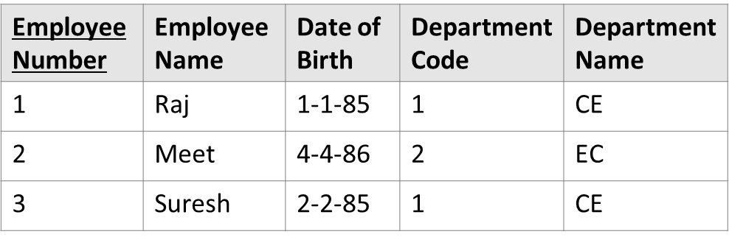
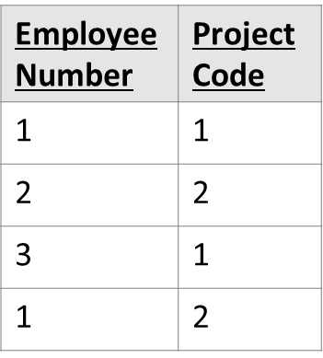
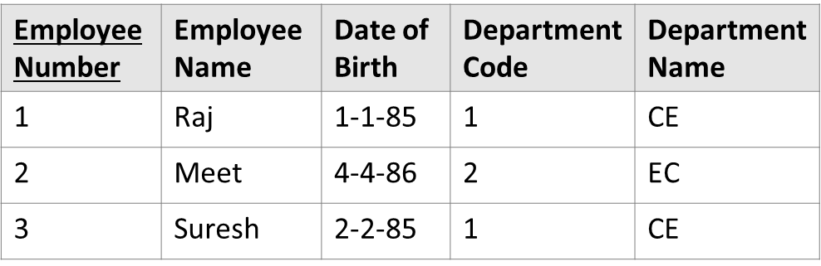
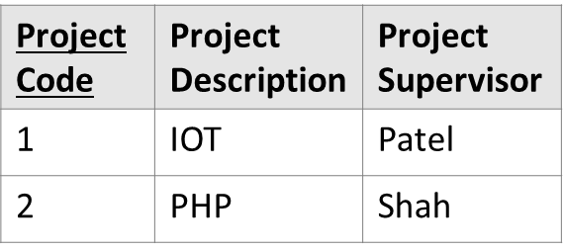
How to normalize database?
1NF
2NF

Slide 61
How to normalize database?
3NF
Employee Number | Employee Name | Date of Birth | Department Code
1 | Raj | 1-1-85 | 1
2 | Meet | 4-4-86 | 2
3 | Suresh | 2-2-85 | 1
Department Code | Department Name
1 | CE
2 | EC
Employee Number | Project Code
1 | 1
2 | 2
3 | 1
1 | 2
Project Code | Project Description | Project Supervisor
1 | IOT | Patel
2 | PHP | Shah

Slide 62
Thank You!!!

Slide 63




www.paruluniversity.ac.in

